Slide 1

CSE (H) with specialization in Machine Learning and Artificial Intelligence
Soft Computing (CSF – 332)
Chapter -1.3
Neural Network Types
By: Dr. Monika Singh E11032
DISCOVER . LEARN . EMPOWER

Slide 2
Course Objectives
To introduce soft computing concepts and techniques of artificial neural networks, fuzzy sets, fuzzy logic and genetic algorithms
To understand the various techniques from the application point of view.
To analyze various soft computing techniques and decide the technique to be used in a particular problem situation.
To implement soft computing based solutions for real-world problems

Slide 3
Course Outcomes
CO1 | Identify and describe soft computing techniques and their roles in building intelligent. Machines | 1
CO2 | Recognize the feasibility of applying a soft computing methodology for a particular problem. | 2,4
CO3 | Apply fuzzy logic and reasoning to handle uncertainty and solve engineering problems, genetic algorithms to combinatorial optimization problems and neural networks to pattern classification and regression problems. | 3
CO4 | Effectively use modern software tools to solve real problems using a soft computing approach. | 3
CO5 | Evaluate various soft computing approaches for a given problem. | 4

Slide 4
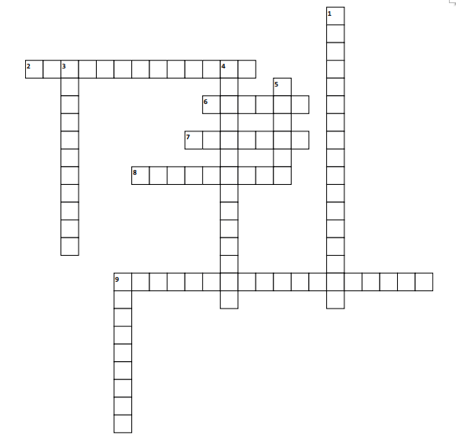
Crossword
Across
2. the basics of atrificial inteligence
6. the values of the set membership is represented
7. adaptive neural neuron
8. Form of fuzzy set
9. properties of fuzzy
Down
1. basics of A.I
3. ANN
4. building block of nueron
5. basics of neural network
9. the logical rules in soft computing

Slide 5
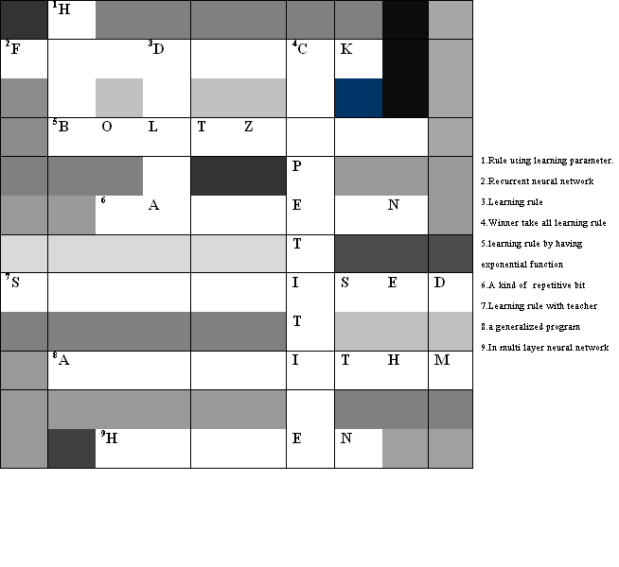
Crossword

Slide 6
THANK YOU
For queries
Email: monika.e11032@cumail.in

